Slide 1
DDSAnalytics
Paul Huggins

Slide 2
Project Scope
Leveraging talent within an organization is a key factor to company success.
The science of developing employees and retaining them is what can separate the great companies from the good ones.
This project focuses on identifying factors that lead to attrition among employees and then predicting employees that have a higher perctnage chance of attrition than others.

Slide 3
In the News
A study published by Business Insider on July 12, 2019 looked at a few of the main reasons employees leave their job:
Lack of career growth.
Lack of support from management.
Lower pay than competitors.
While these may or may not apply to this analysis, this topic is widely covered in many business journals and understanding the reasons behind attrition and how to prevent it can save money.
Source: https://www.businessinsider.com/the-main-reason-an-employee-would-quit-a-job-2019-6

Slide 4
The Data Set
Information on 870 employees were provided for analysis.
Types of information provided were:
Age, Gender, Income, Department, Role, Education, Travel, Satisfaction Ratings, Performance Ratings, Marital Status, Work History, Overtime, Stock Options, Working Years, Time at Company, and many more…
In total there were 35 unique variables for each employee that were to be used to predict attrition.

Slide 5
Base Attrition Rates for Comparison
Of the 870 employees in the data set, 140 of them left the company (16.1%).
The remaining 730 stayed with the company (83.9%).
The current base attrition rate for the company is 16.1%.
According to a 2016 study by Compensation Force, the average attrition for all industries was 17.8%. Rates vary by industry.
Source: https://www.compensationforce.com/2017/04/2016-turnover-rates-by-industry.html

Slide 6

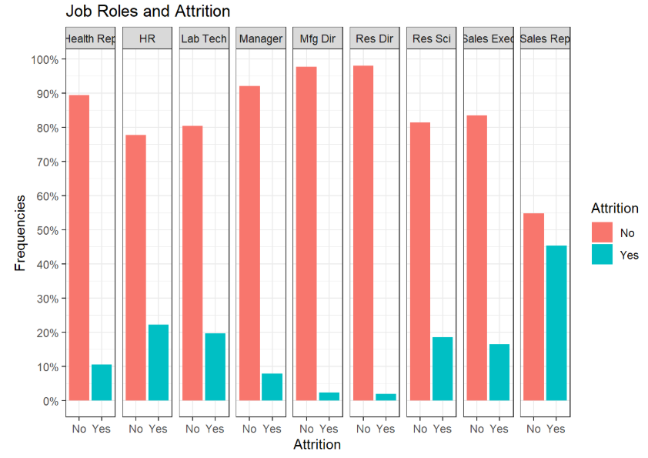
Attrition by Job Role
An important statistic regarding attrition is its’ correlation to Job Role.
Each job role is different and attracts different individuals, but what was the attrition rate for each job role varies widely and is a good reference point.
Sales Representatives make up nearly 45% of all employees who left the company, this is the largest by far.
The lowest attrition comes from Manufacturing Directors (Mfd Dir) and Research Directors (Res Dir).

Slide 7
Key Factors for Attrition
To determine which factors have the largest influence on attrition, a correlation test was run. The values are from 0 to 100 with 100 being 100% correlation and 0 being 0%.
Below are the top 5 factors that are attributed with attrition at the company and their relative correlation.
Overtime: 27.2
Marital Status: 19.7
Job Involvement : 18.7
Total Working Years: 16.7
Job Level: 16.2
We will focus on the top 3 for the time being.

Slide 8
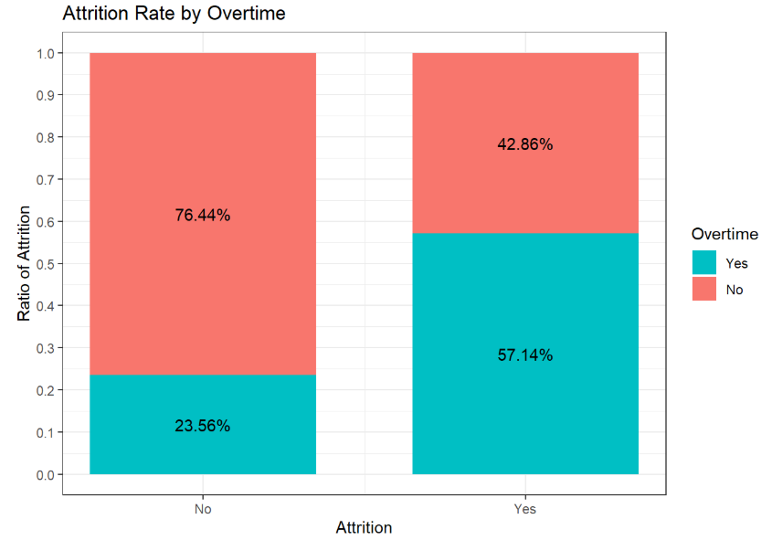
Attrition and Overtime
Overtime was defined as a Yes & No variable solely indicating if the employee worked overtime or not.
The left bar is employees who did NOT leave the company.
The right bar is employees who DID leave the company.
Employees that work overtime have an attrition rate that is 34% higher than employees who do not work overtime.

Slide 9
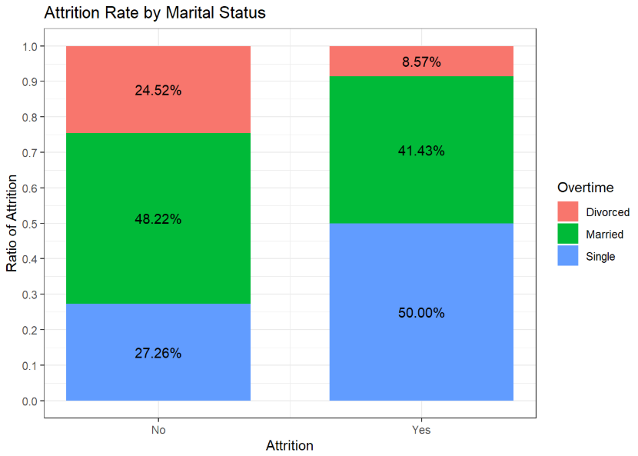
Attrition and Marital Status
Marital Status is defined by either Divorced, Married or Single.
The plot suggests that single employees have the highest rate of attrition at the company (50%) and divorced employees have the smallest rate (8.5%).
Marital Statues needs to be used with caution when evaluating attrition since there are many contributing factors that may tie into to it.

Slide 10
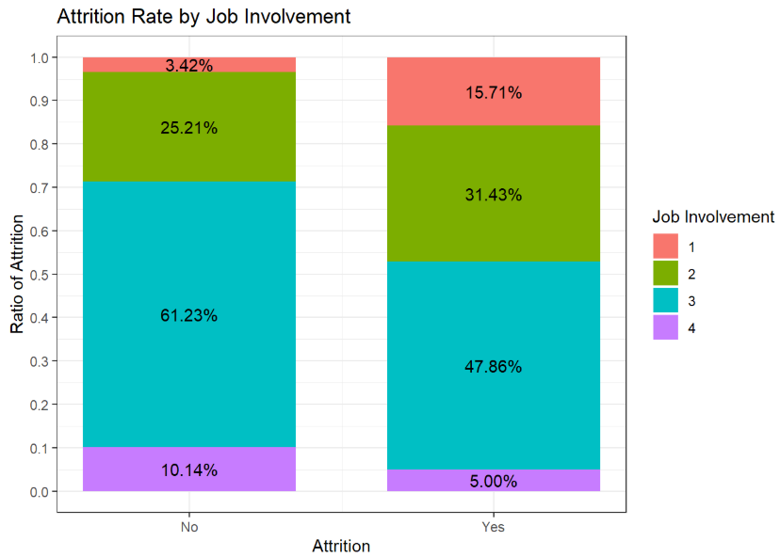
Attrition and Job Involvement
Job Involvement is a ranking from 1 to 5 with 1 being least involved and 5 being most involved.
Employees with a ranking of 1 and 2 show an increase in attrition rates.
This is an indicator that employees who are not very involved in their roles have an increased rate of attrition compared to employees who are very involved.

Slide 11
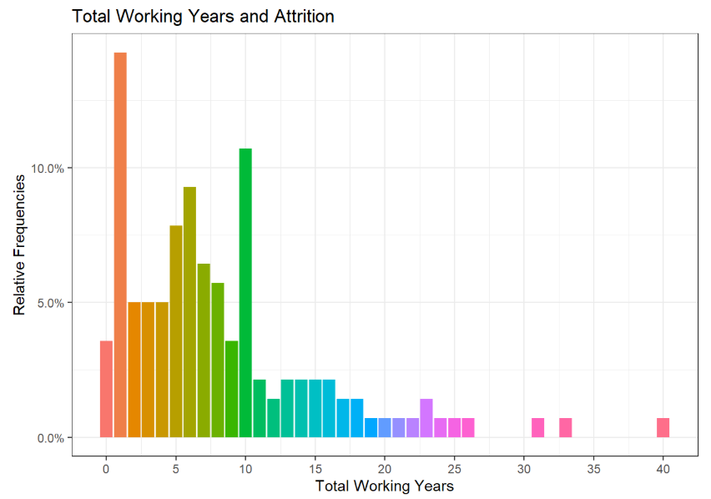
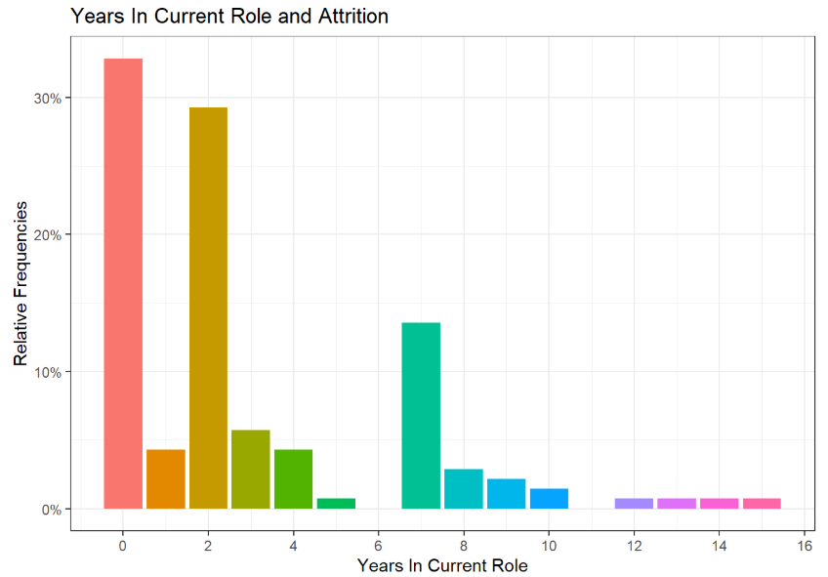
Other Attrition Factors
Total Working Years
The more years an employee has worked shows a decrease in attrition rates. This is not years worked at this company but instead is a total over their career.
Years in Current Role
Employees who have been in their role for less than a year have the highest attrition rates. Employees in their 2nd and 7th years in the role have the next highest rates.

Slide 12
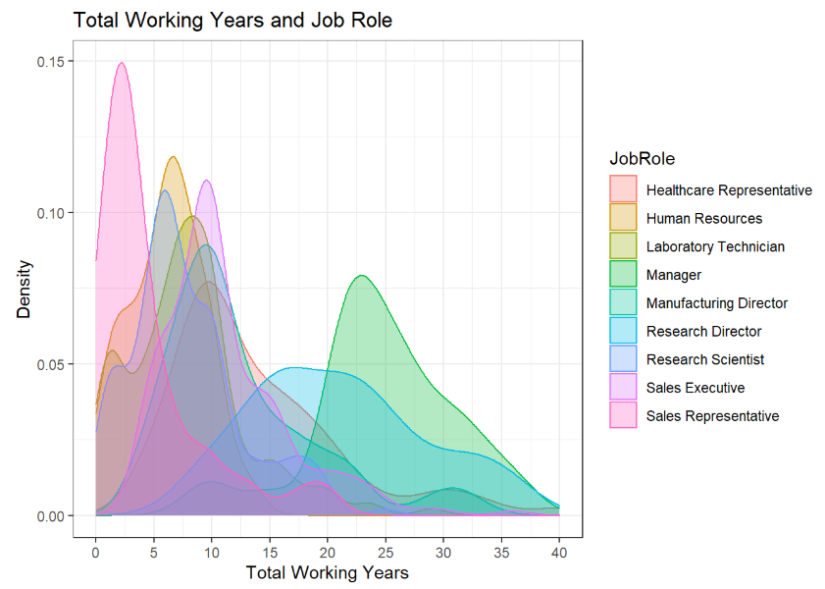
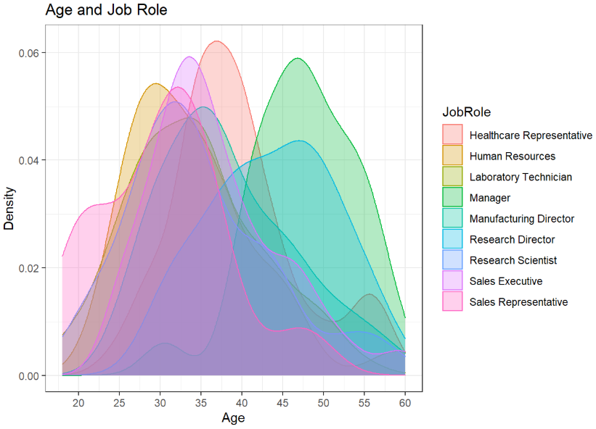
Job Role Specific Trends
Total Working Years
The majority of job roles have an employee total working years from 0-10. Managers and Research Directors have generally worked for 15+ years.
Age
The majority of the employees are aged between 25-45. Managers and Research Directors have the oldest mean age of around 47 years old.

Slide 13
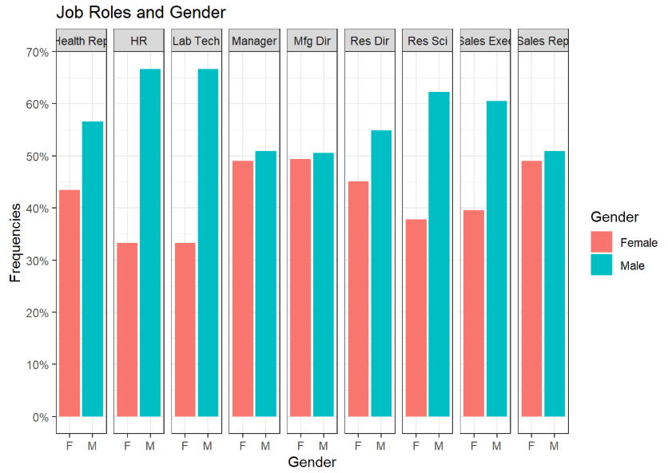
Job Role and Gender
Looking at Job Role and Gender, there is a good distribution at the management level.
Nearly 50/50 for Manager & Manufacturing Director and 45/55 for Research Directors.
The other job roles leaned towards male employees, but this could be a product of the industry itself and the normal gender attracted to these roles.

Slide 14
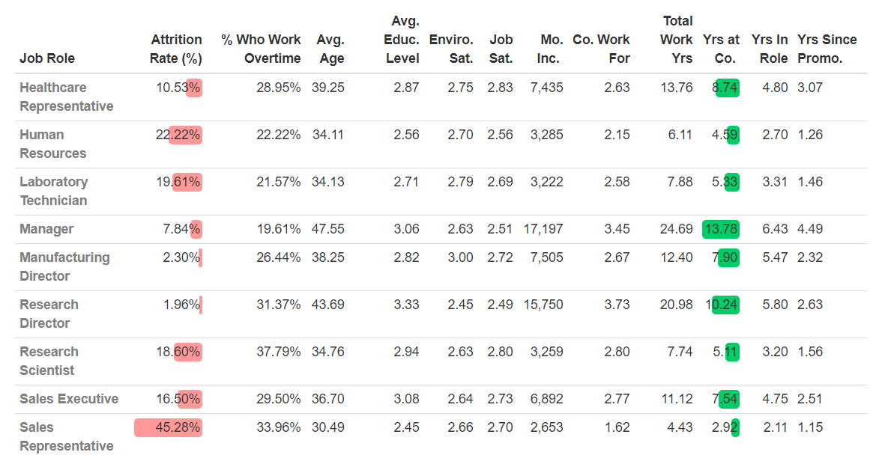
Job Role Summaries
Looking at trends among job roles led to the notion of a comparative analysis on each role by department. The following table shows various attributes regarding each job role. Factors that showed no significant difference between job roles were excluded.
The following slides will break this table down by department.
The managers is an aggregate from each department that will be split out in future slides.

Slide 15

Human Resources
Human Resources:
Nearly ¼ of these employees leave and ¼ work overtime.
With an average age of 34, total working years of 6.11 and years in role being 4.59, this is most likely one of the first few jobs for these employees.
HR personnel have one of the lowest years since promotion among all employees which is concerning given having the 2nd highest attrition rates. Other factors contributing to this attrition rate could be the monthly income, which is one of the lowest.

Slide 16
Research and Development
Compared to other departments, Research and Development has the lowest average attrition rate and the highest years at the company.
Noticeable takeaways:
Research scientists have the highest percentage of employees who work overtime as well as one of the lowest monthly incomes… yet have the 2nd highest job satisfaction!
Research directors have the lowest attrition rates among all employees and one of the highest years at company averages, but also have the lowest job satisfaction ratings at the company. This seems odd given their salaries and high ratings in the other categories.

Slide 17
Sales
The sales department has the highest average attrition rate, but this is slightly skewed given the large percentage of sales representatives who leave.
A study published by LinkedIn on December 3rd, 2017 cites that the average sales representative turnover in the United States is around 34.7%. This company is seeing percentages 10%+ higher than that. This could be a byproduct of the role itself or simply the market it operates in.
Both job roles within the sales department work have about 1/3 of their employees working overtime which is not uncommon for sales role and they actually have fairly high job satisfaction ratings.
If there were an opportunity for stabilization and retention, this department could utilize it. Given more data, an analysis on human costs could provide some useful insight. Below are some of the questions I would be interested in asking:
What is the average cost to hire and train a sales representative?
If the attrition rate was decreased by even 10% to meet the national average, what is the cost savings for the company? Might it be worth investing in these employees more to decrease the turnover rates?
Source: https://www.linkedin.com/pulse/why-turnover-so-high-b2b-sales-anthony-chaine/

Slide 18
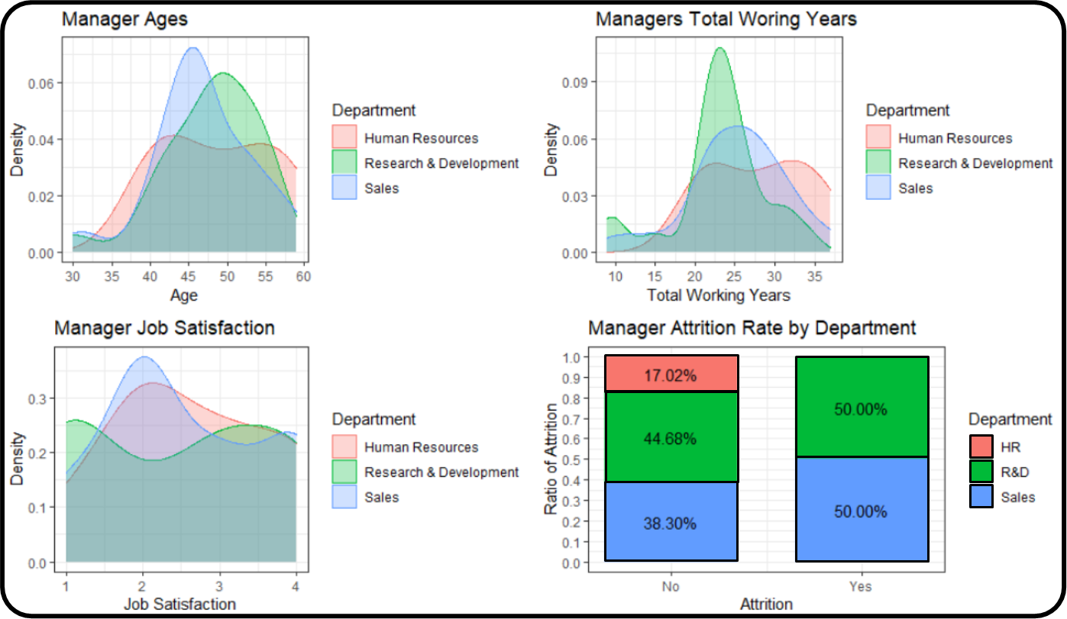
Manager Analysis by Department
The average age of managers is around 45-50 years old. Human Resources managers have the widest range of ages.
The total working years is very similar to manager ages with a very high percent of the total years being around 20-25.
Manager job satisfaction is generally a 2. The Research and Development managers have a more broad range with the majority coming in at a 1 or a 3.
Attrition rates among managers is the most interesting graph among these. NONE of the Human Resources managers left their job. Granted there were only 8 of them in the dataset, the fact that none of them left is a strong takeaway here.

Slide 19
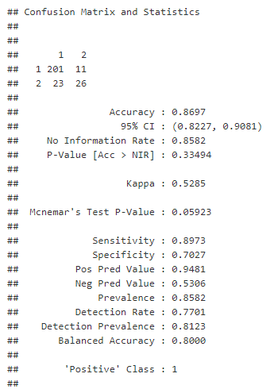
Predicting Attrition
A Naïve Bayes model was built to predict attrition among employees.
This model was chosen due to it having an affinity for smaller datasets similar to this and a strength for using multiple different data categories.
This model has an overall accuracy of 86.9%. It can correctly predict if employees will leave with 70% accuracy and has an accuracy of 89% when predicting if employees will stay.

Slide 20
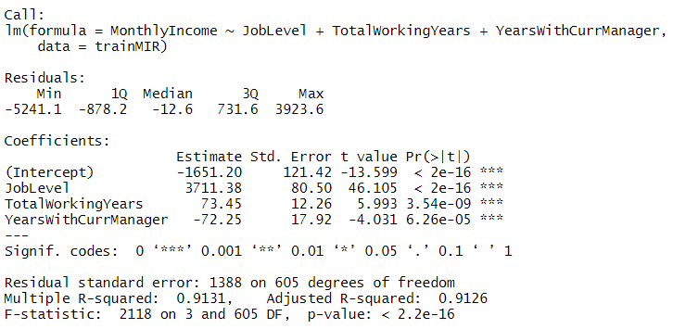

$$Predicted Monthly Income=B0+3711.38\left(Job Level\right)+73.45\left(TotalWorkingYears\right)−72.25(YearsWithCurrManager)$$
Predicting Monthly Income
Linear regression was used to predict monthly income of an employee.
The following variables had the some of the highest correlation to the Monthly Income:
Job Level
Total Working Years
Years With Current Manager
Each of these variables is statistically significant judging by the Pr(>|t|) values in the right column of the Coefficients table.
The Root Mean Squared Error for the model is 1,382.99.

Slide 21
Thank You

